Slide 1
Marketing & Sales Plan
Notes:
In 2006, nearly 650,000 businesses were started in the US.
More than 550,000 closed.
This class is intended to improve your chances for success in launching a new business enterprise.

Slide 2

Business Plan
10 Steps
Executive Summary
Value Proposition
Company Description
Market Description & Opportunity Assessment
Product/Service Description
Competitive Assessment
Marketing & Sales Strategy
Operations
Management and Employees
Financial Summary
Marketing/Sales Plan
Notes:
This particular organization is based on developmental order.

Slide 3

What is Marketing?
Marketing is the process of planning and implementing pricing, promotion, sales, and distribution of your goods and services.
Marketing/Sales Plan

Slide 4

Marketing Goals
Present your product or service to target customers in a way that makes them more attractive than the alternatives
Increased sales!
All the target customer needs is to know about your product
Marketing/Sales Plan

Slide 5

Marketing Plan
Promotion Section
  Plan to communicate your product and business information to the target market
Sales Section
  Mechanics of the sales transaction
Distribution Section
  Decisions regarding product delivery to customers
Marketing/Sales Plan

Slide 6

Promotion
Business Cards
Advertising
Signage
Flyers
Direct Mail
Internet
Telemarketing
Trade Shows
Public Relations
Sales Promotion
Networking
Specialty Items
Marketing/Sales Plan

Slide 7

Business Cards
The most used promotional tool
Business Name, Your Name, & Contact Info
Inexpensive ($15/250)
Print Shop/Internet/DIY
Distribute liberally
Marketing/Sales Plan

Slide 8

Advertising
Broad Audience
  TV, Radio, Newspaper, Magazines, Internet
  Pay for views not in Target Market
Focused Audience
  Regional Media
  Interest Media
  Yellow Pages
  Internet
Generally Involves Creative Agency
Marketing/Sales Plan

Slide 9

Advertising
Need for Repetition
Good for Awareness
May not Change Behavior
Coop Funding Possibilities
Google AdSense
Marketing/Sales Plan

Slide 10

Signage
Often Overlooked
Catchy Name or Well Designed Logo gets Attention
Marketing/Sales Plan

Slide 11

Flyer/Inserts
Low Cost
Easily Updated
Effective if able to Target Specific Geographic area
Low Impact if Broadcast
Marketing/Sales Plan

Slide 12

Direct Mail
Low Cost
Low Response for “Junk” Mail
Personalize for Better Response
Difficult to Get Good Mailing Lists
Marketing/Sales Plan

Slide 13

Internet
Web Page now Expected
Email as a Response Vehicle
Low Cost Response Vehicle
Marketing/Sales Plan

Slide 14

Telemarketing
Rapidly Falling From Favor
Potential for Backlash
Marketing/Sales Plan

Slide 15
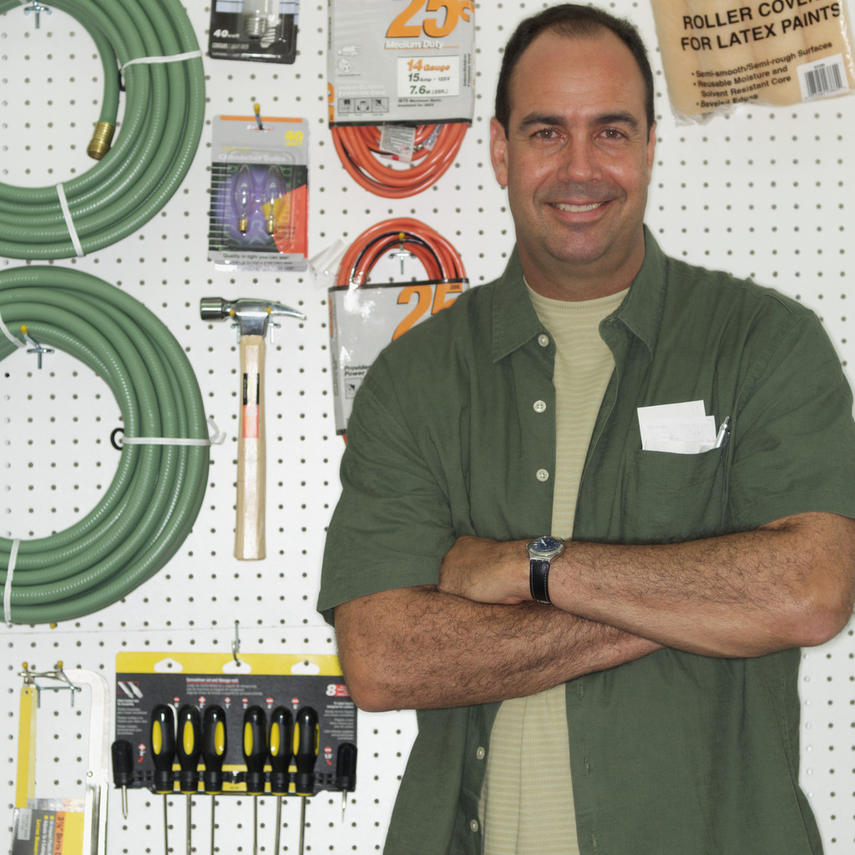
Trade Shows
Benefit from Others Generating Traffic
Low Cost
Large Time Commitment
Take-away Piece
Can’t be Passive
Speaking Opportunities
Marketing/Sales Plan

Slide 16

Public Relations
No Cost!
Press Releases
Event Notification
Community Notices
Article Placement
Short Duration
No Editorial Control
Marketing/Sales Plan

Slide 17

Sales Promotion
Target Immediate Sales
Coupons & Discounts
Contests
Giveaways
Permanent Effect?
Marketing/Sales Plan

Slide 18

Networking
Speaking Engagements and White Papers
Volunteer “Expert”
Civic Organizations
Free, powerful, hard to control
Long Term Investment
Marketing/Sales Plan

Slide 19

Specialty Items
Sponsorships
  Celebrity Speaker
  Sports Team
  Race
  Charities
Holiday Gifts
Frequent Buyer Program
Marketing/Sales Plan

Slide 20



Integrated Marketing
Each element of your marketing plan connects and reinforces
Common theme and message
Amplifies your marketing investment
Marketing/Sales Plan

Slide 21
Marketing Plan
Promotion Section
  Plan to communicate your product and business information to the target market
Sales Section
  Mechanics of the sales transaction
Distribution Section
  Decisions regarding product delivery to customers
Marketing/Sales Plan

Slide 22
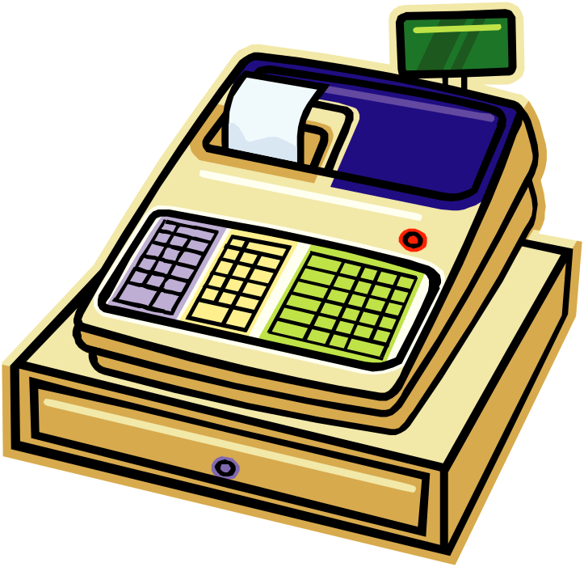
Sales Decisions
Sales Force
  Only 30% of time spent selling
  Highly Effective
Reps/Independent Sales Agents
Retail Storefront
Mail Order
Internet Sales
In a Small Business, the Owner/Manager is the Most Effective Salesperson
Marketing/Sales Plan

Slide 23
Marketing Plan
Promotion Section
  Plan to communicate your product and business information to the target market
Sales Section
  Mechanics of the sales transaction
Distribution Section
  Decisions regarding product delivery to customers
Marketing/Sales Plan

Slide 24

Distribution Decisions
Retail
Wholesale
Customer Pick-Up
Door to Door
Mail
Delivery Service
In Home Trials
Marketing/Sales Plan

Slide 25

Costly Marketing Mistakes
Focus on Your Company vs Customer
Not Knowing Your Customer
Not Understanding Your Differentiation
Marketing to the Wrong Customers
Shotgun Approach
Neglecting to Incite Buying Action
Not Standing Behind Your Product
Marketing/Sales Plan

Slide 26

Marketing Strategies
Clearly define the niche and fill it
  Target markets
  Put Names/Faces to Your Customers
Marketing/Sales Plan

Slide 27

Marketing Strategies
Don’t just sell – Entertain
  34% of consumers are driven more by emotional factors like fun than by logical factors such as price
Marketing/Sales Plan

Slide 28

Marketing Strategies
Strive to be Unique
  Stand out of the crowd
Marketing/Sales Plan

Slide 29

Marketing Strategies
Connect at an Emotional Level
  Common Causes
  Exceptional Service
  Personal Touch
Marketing/Sales Plan

Slide 30

Marketing Strategies
Focus on the Customer
  Smaller Companies often have an Advantage by putting Customers at the Center
Marketing/Sales Plan

Slide 31

Marketing Strategies
Devotion to Quality
  Total Quality Management is not only the product, but also very aspect of the customer relationship
  See the World from a Customer’s View
Marketing/Sales Plan

Slide 32
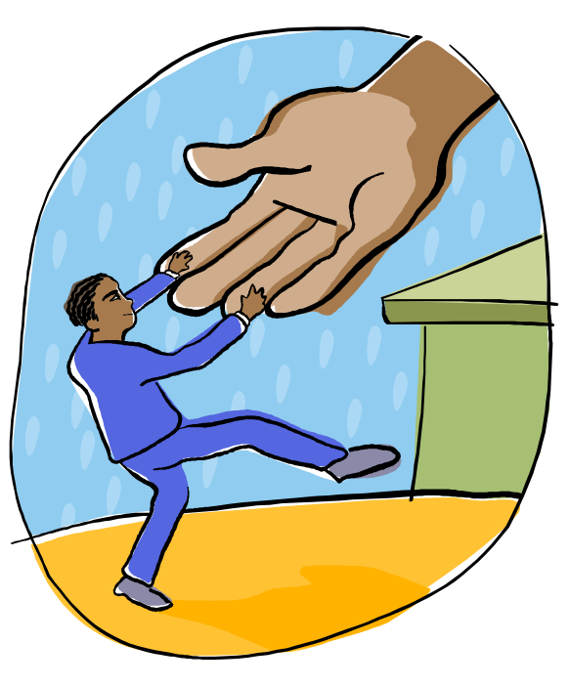
Marketing Strategies
Attention to Convenience
  Creating Convenience Attracts and Retains Customers
Location
Purchase Terms
Business Hours
Delivery
Marketing/Sales Plan

Slide 33

Marketing Strategies
Constantly Innovate
  Markets change and so Must You
  Small Business has an Advantage
Marketing/Sales Plan

Slide 34

Marketing Strategies
Emphasize Speed
  Immediate gratification
  = increased sales
Marketing/Sales Plan

Slide 35

Marketing Plan
Promotion Section
  Plan to communicate your product and business information to the target market
Sales Section
  Mechanics of the sales transaction
Distribution Section
  Decisions regarding product delivery to customers
End of Marketing/Sales Plan Presentation

